Slide 1
Evaluating the Timor-Leste National Eye Health Strategy from a Rights-Based Perspective
School of Public Health and Community Medicine
Australasian Evaluation Society 2011 International Conference
29 August – 2 September 2011
Hilton Hotel, Sydney

Slide 2
Project partners and team members
UNSW, School of Public Health & Community Medicine
Dr Ilse Blignault, Ms Jacqueline Ramke & Prof Anthony Zwi
University of Auckland, Centre for Development Studies
Dr Carmel Williams
National University of Timor-Leste (UNTL)
Faculty of Medicine & Health Sciences & National Centre for Science Research
Dr Joao Martins
Ministry of Health Timor-Leste (MOH)
Sr Basilio Pinto, Office of Policy Development
Sr Duarte Ximenes, Directorate of Human Resources

Slide 3
UNSW in Timor-Leste
SPHCM & MOH partnered: Timor-Leste Health Care Seeking Behaviour Study Health Sector Resilience Study (2006 crisis) Health System Research Capacity Building Project.
Staff and students involved in many research studies and evaluations in health field.

Slide 4
Presentation overview
Country context
Eye health
TLNEHS 2006–11
Proposed evaluation
Strategies to maximise influence
Questions

Slide 5
Geography and population
Population of 1,066,582 (2010 Census), 70% rural

Slide 6
Historical and development context
May 2002, formal independence after four centuries as Portuguese colony, 42 years Indonesian occupation and 2 years UN administration.
Good progress, but remains fragile post-conflict state and least developed country in Asia.

Slide 7
Government
All systems in early stages of development.
Constitution affirms the recognition and respect for human rights as stipulated in the Universal Declaration of Human Rights, and embeds health and medical/health care as fundamental rights for all citizens.

Slide 8
Key values of the Ministry of Health
Equidade
Ética
Amizade
Justiça Social
Solidariédade

Slide 9
Eye health: issues
2005 population-based survey of adults ≥40 years:
7.4% blindness and 17.7% low vision
Cataract and uncorrected refractive error caused >90% of all vision impairment
Approx 47,000 people had some vision impairment; approx 10,000 had blinding cataract
2/3 had not sought care.

Slide 10
Eye health: actors
3 ophthalmologists based in Dili with outreach services to rural referral hospitals.
Permanent eye clinics staffed by nurses/technicians with one year of training in some districts.
INGOS: FHFNZ and RACS (cataract surgical services)
Local NGO: FNTL (National Spectacle Program)

Slide 11
TL National Eye Health Strategy (TLNHES)
Evidence-informed strategy which came into effect in 2006.
Based on 2005 population-based survey and audit of surviving services.
Prioritised primary eye care and management of cataract and refractive error.
5-year strategy (2006–2011) requires evaluation and updating.

Slide 12
Evaluation literature (1)
Kirkhart (2000) – developed integrated theory of evaluation influence with which to examine evaluation effects that are multidimensional, incremental, unintentional and noninstrumental alongside those that are unidirectional, episodic, intended and instrumental (captured by the term evaluation use).
Conceptual framework has three dimensions: (1) source of influence, (2) intention and (3) time.

Slide 13
Evaluation literature (2)
Mark and Henry (2004) added to framework by identifying and classifying underlying mechanisms.
Empirical studies demonstrate importance of both high-quality evaluation and high-levels of stakeholder engagement and participation for evaluation influence. Understanding contextual factors is critical.

Slide 14
Evaluation overview
Proposed evaluation designed to maximise its use and influence:
Builds on existing relationships and will be conducted as a partnership between UNSW, UNTL and MOHTL
Will adopt a capacity-building approach
Will model a collaborative, evidence-informed approach to policy
Will prepare stakeholders for next TLNEHS.

Slide 15
Objectives
Describe the process of developing TLNEHS
Assess implementation, outcomes, obstacles and challenges to TLNEHS
Contribute to evidence-informed policy making and health system strengthening
Enhance capacity of Timorese partner institutions and individuals to draw evaluation and other evidence into strategic planning processes.

Slide 16
Human Rights Framework
National commitment to progressive realisation of health rights.
Evaluation will assess to what extent the TLNEHS respected, protected and fulfilled people’s health rights in Timor-Leste: to what extent did it improve eye health while at the same time strengthening other aspects of the health system?

Slide 17
Data sources
Document analysis
Second national eye health survey (2010)
Qualitative studies
Service delivery data
Community and civil society perspectives
Key informant interviews

Slide 18
Instruments (1)
Questionnaire 1 (123 indicators): Extent to which TLNEHS design was based on the realities of the capacity and context of the health system in Timor-Leste at the time.
Questionnaire 2 (36 indicators):
Extent to which TLNEHS resulted in eye care services that were available, accessible, acceptable and of good quality.

Slide 19
Instruments (2)
Questionnaire 3 (22 indicators):
Rights-based health system impact assessment. TLHEHS impact on health services, goods and facilities; health workforce; health information system; medical products, vaccines and technologies; national financing; governance and leadership.

Slide 20
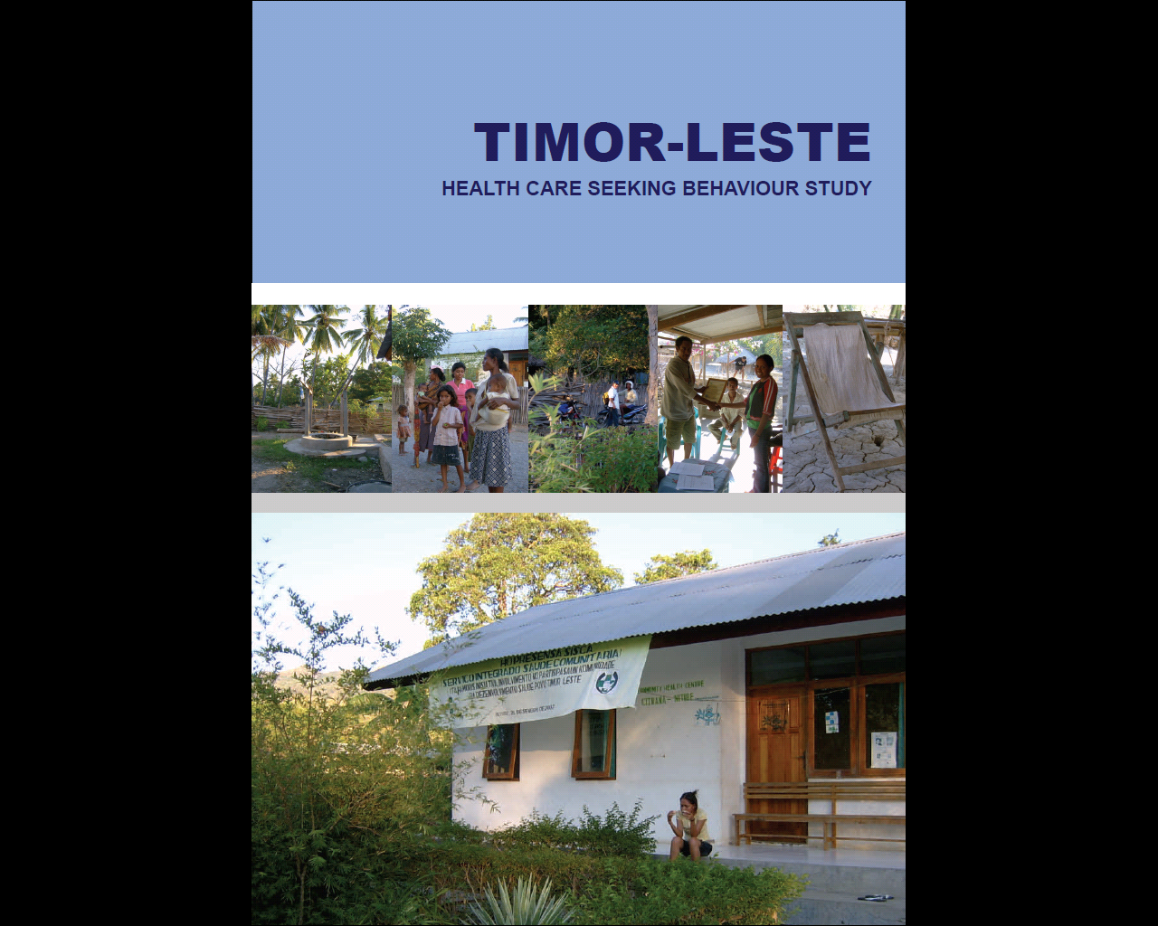
Relationships and communication
Previous partnerships and existing relationships
Advisory Committee
Onsite meetings and via technology

Slide 21
Influencing policy
‘Evidence informed’ policymaking sees the use of different types of information in a variety of forms and from a variety of sources, reflective of and responsive to the policy and practice context.
Bowen & Zwi, PloS Medicine, 2005

Slide 22
Enhancing capacity
Evaluation will promote collaboration between the MOH and UNTL, and within UNTL between FMCS and CNIC, while building capacity in using rights-based and evidence-informed approaches to services delivery and policy issues.
Others stakeholders also able to nominate staff to participate in seminars, workshops.

Slide 23
Summary
Completion of first TLNEHS presents unique opportunities to conduct in-depth review of both process and outcome, and use experience and lessons to strengthen developing system.
Knowledge and understanding gained have relevance for understanding issues and challenges with respect to the right to health, enhancing implementation – prevention and service provision, and refining mechanisms to inform policy and strategy with evidence

Slide 24
Thank you Comments? Questions?

